Slide 1
Why was the American West so fiercely contested in the years 1835-1895?

Slide 2
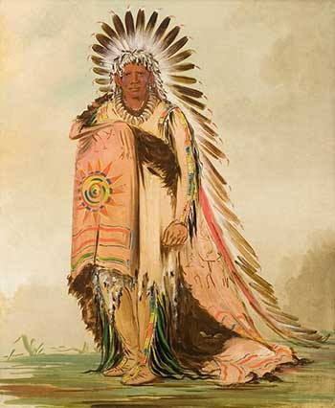
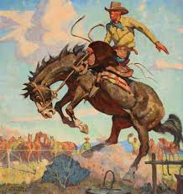
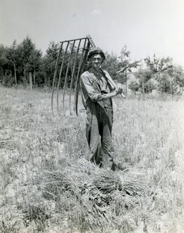
In this study you will meet three groups of people . Can you identify them from these images?

Slide 3
… Plains Indians, cowboys and farmers (homesteaders) all had a claim to the land of the American West. Members of each group came into contact – and conflict – with the other groups, as they fought for control of this land in the 1800s.

Slide 4
BIG Q: Why was the American West so fiercely contested in the years 1835-1895? An overview
Objectives:
Gain a contextual understanding in which to place the development of the American West.
Categorise key events from the unit according to the group whose experiences they describe.
So we can:
Make inferences about the life of Plains Indians, homesteaders and cowboys in the American West.
Judge the accuracy of a number of statements about life in the American West.
Key words: Colonisation, Colonies, Plains Indian, settler, migrant, homesteader, cowboy, cattle rancher.

Slide 5
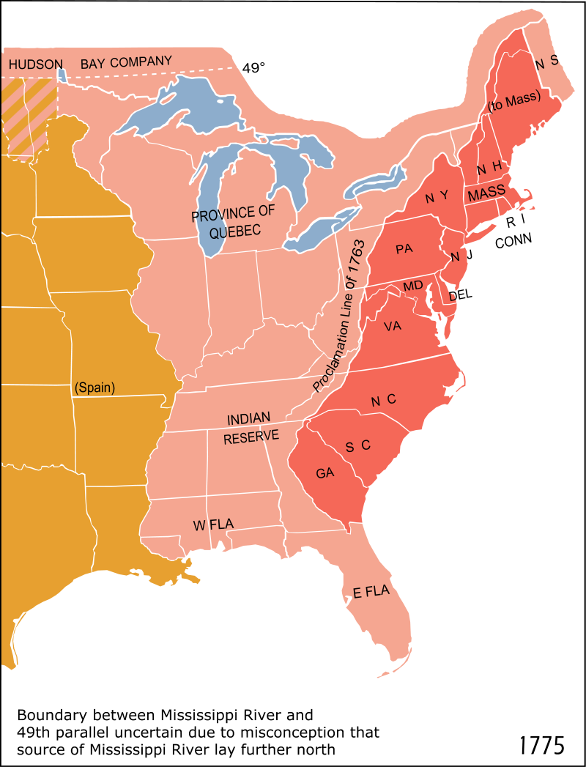
In 1492, Italian explorer Christopher Columbus arrived in America, and this marked the beginning of the European Colonisation of the Americas.
By the 1760s, there were thirteen colonies along the eastern coast of America, which were ruled over by the British.
Many British people lived in the colonies, and they supervised the work of slaves and local natives.
Map showing the thirteen British colonies (in red).

Slide 6
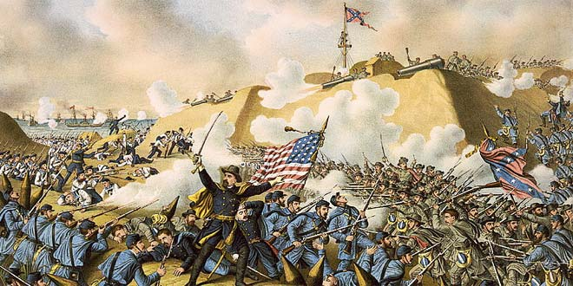
However, resistance to British rule led to the American Revolutionary War of 1775-6 (also known as the American War of Independence).
When George Washington’s forces from the thirteen colonies won the war, their independence from British was declared.

Slide 7
It was in this context that the ‘American West’ became an important and disputed region.
In 1800, the ‘United States’ only really included territories on the eastern coast of America: the West was largely unsettled by white Americans, as it was occupied by native tribes.
A number of events in the early 1800s meant that this situation was about to change…
Territories of ‘United States’
American West

Slide 8
In this unit, you will focus on three groups of people.
Although these groups had very different experiences during the period 1835-1895, their lives intersected in several important ways.
Each group was significantly affected by the westward expansion that took place after 1800…

Slide 9
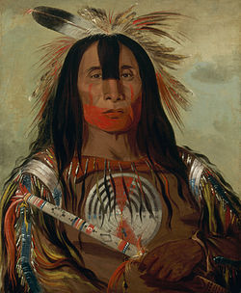
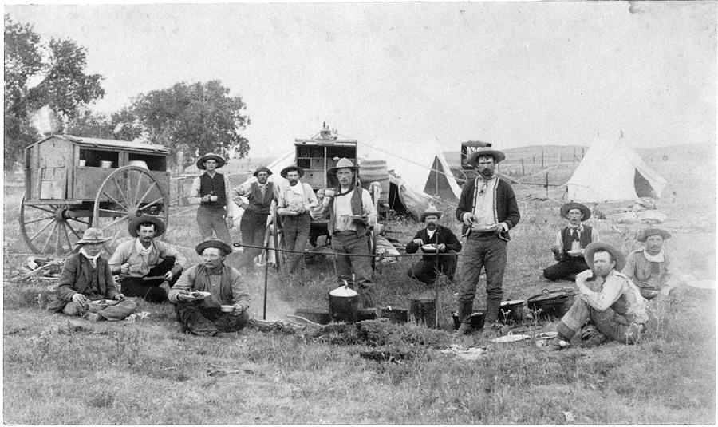
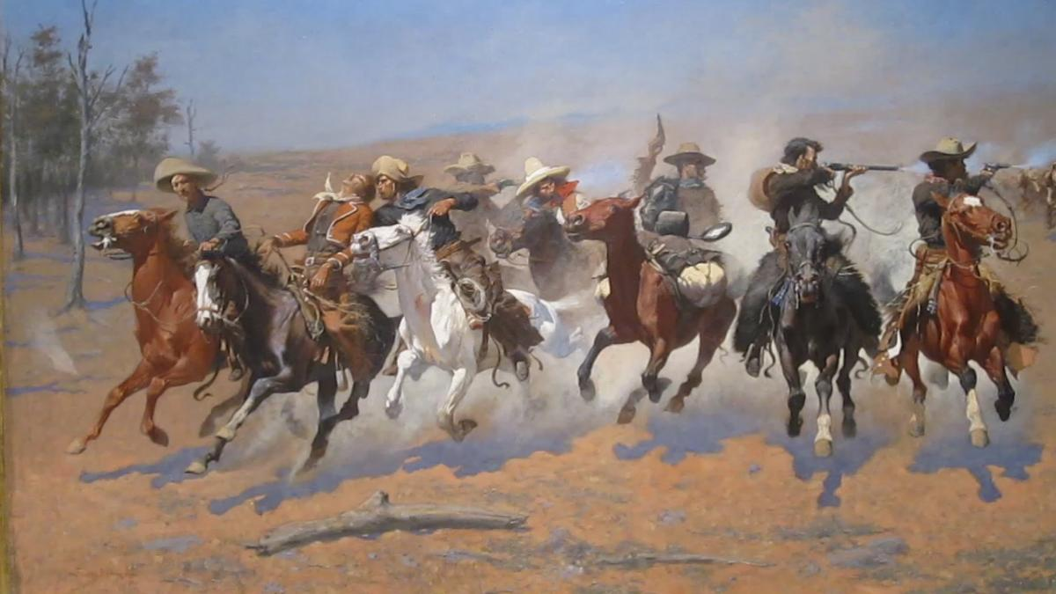
The migrants and homesteaders.
The Plains Indians.
The cowboys and cattle ranchers.

Slide 10
TASK: Read the cards on R.S1, and match them up with the correct image on R.S2. Lay them out in their pairs on your desk.

Slide 11
R.S1 Key events in the American West
In 1848, a carpenter called James Marshall discovered gold in California. Once news of the discovery spread, thousands of migrants made the journey to California to seek out gold. | In 1874, barbed wire was invented. This invention changed the lives of settlers who had moved West, because for the first time they could protect their new land holdings from wandering cattle. This allowed them to become more prosperous. | In 1890, a group of US soldiers opened fire on a group of Sioux Indians who were simply performing a ritualistic dance. The event became known as the Wounded Knee Massacre.
The Indian Frontier Act of 1834 meant that there was a permanent divide between lands designated to the Plains Indians, and ‘white American’ lands. | In 1890, the US government announced the closure of the Indian Frontier. After this point Plains Indians were not considered to have their own identity: they had to integrate into US society and culture. | In 1837, the USA suffered an economic depression, which saw many banks in the East collapse. People lost their savings, wages fell and unemployment rose. Many people decided to seek their fortunes in the West.
Cattle ranching had been established in Johnson County since the 1870s, and wealthy ranch owners wanted to extend their power. In 1892, the cattle barons employed a vigilante group to get rid of ‘rustlers’ stealing their cattle. | In the 1850s, vigilance committees were formed in response to the crime and violence that went on between cowboys and cattle ranchers in the new towns of the West. | In 1867, Joseph McCoy realised the potential of the city of Abilene as a transit point for cowboys wanting to move their cattle to the big cities of the North.
The 1851 Fort Laramie Treaty said that certain lands belonged to Plains Indians, as long as the Indians allowed white migrants to travel across those lands. | In 1846-7, a large group of Mormons – facing persecution and discrimination in the East – decided to migrate to Salt Lake City in Utah. The migration took several months, and the journey was hard. | Billy the Kid was a famous gunfighter, employed by a group of ranchers to protect their business interests against rival businesses. Billy was eventually killed in 1881 after a bounty was put on his head.
The Pacific Railroad Act of 1862 provided funding for two railroad companies to extend the railroads further West. The completed railways allowed even larger-scale migration westward. | An armed force led by a US colonel attack Black Kettle’s camp of Cheyenne Indians at Sand Creek in 1864. The attack happened in revenge for Plains Indian attacks on the wagon trains of settlers. | The 1876 Battle of the Little Bighorn saw the US army defeated by the Plains Indians, and the famous US army leader, General Custer, killed.
The 1870s saw a ‘beef bonanza’, as demand for beef in the big cities increased dramatically. This allowed several cattle ranchers to become very rich, and they became known as ‘cattle barons’. | Between 1861 and 1865, the Northern US states fought a Civil War against the Southern states. Eventually, the Northern states won. Keen to consolidate their hold over the whole of the USA, the Northern government encouraged migration West. | In 1889, Ella Watson and Jim Averill – the owners of a homestead in Wyoming – were accused of stealing cows from local ranchers. The ranchers decided to take it upon themselves to eradicate ‘rustlers’, and both Watson and Averill were killed.

Slide 12
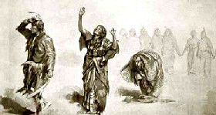
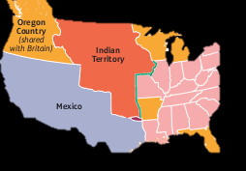
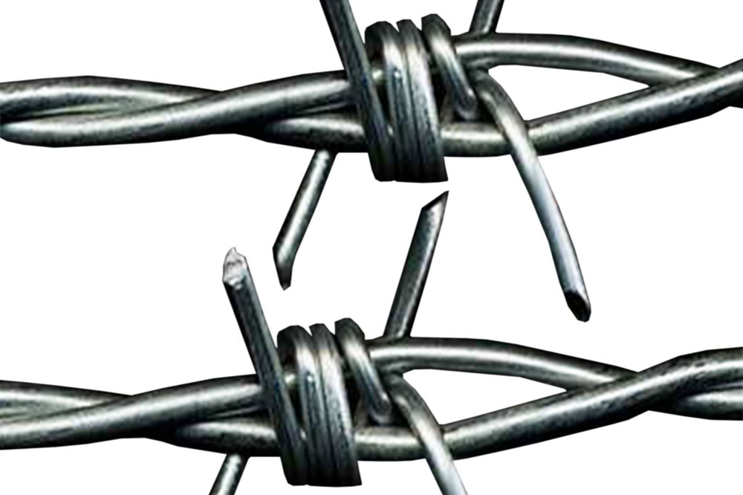
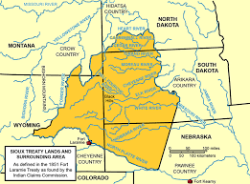
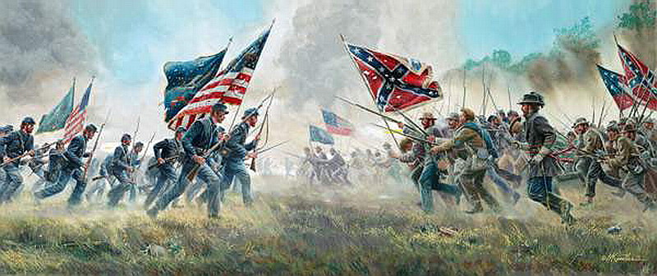
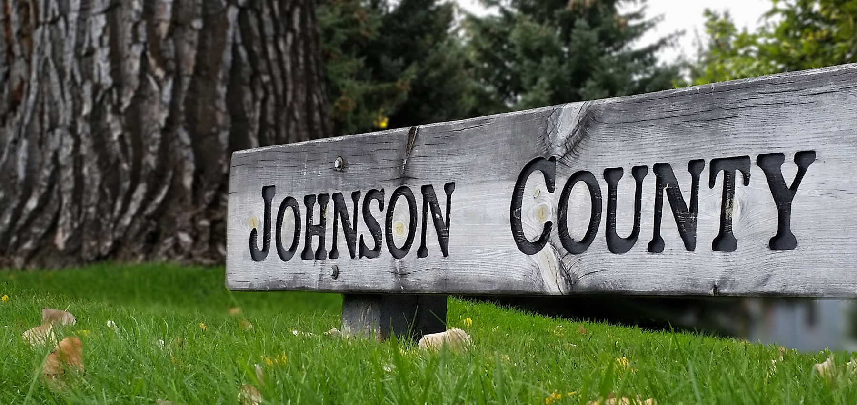
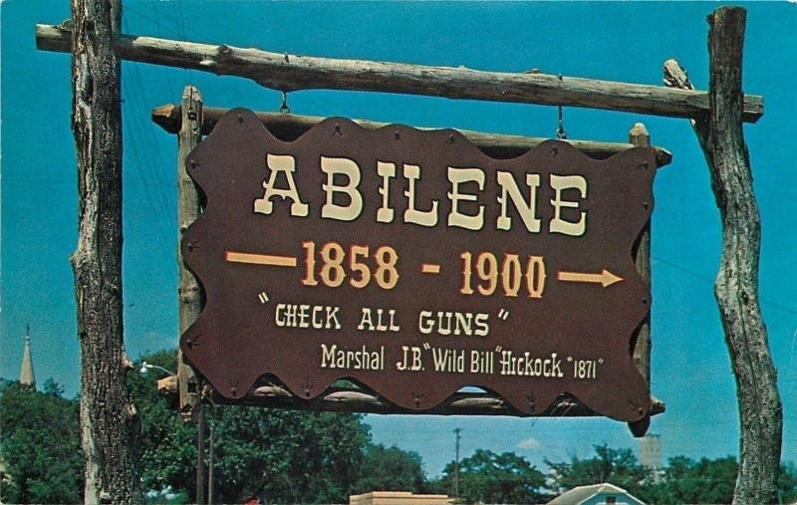
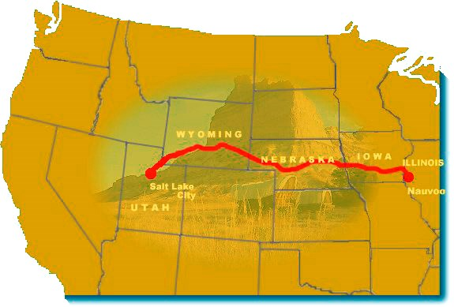
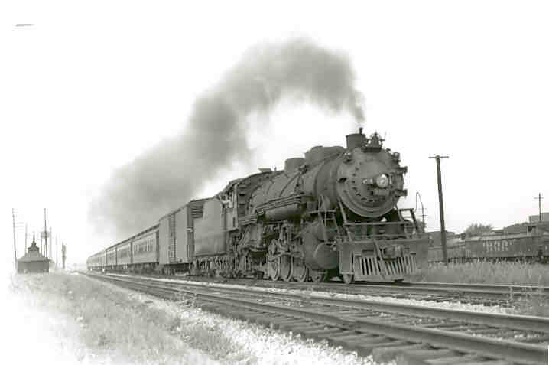
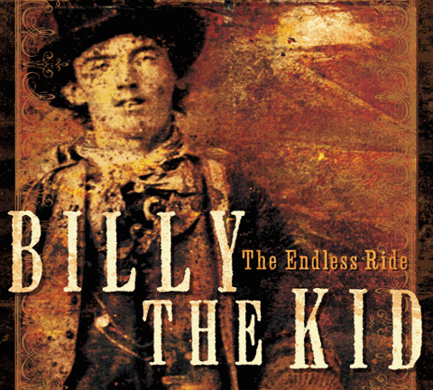
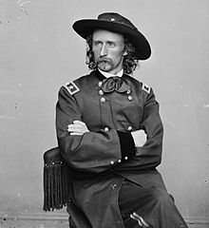
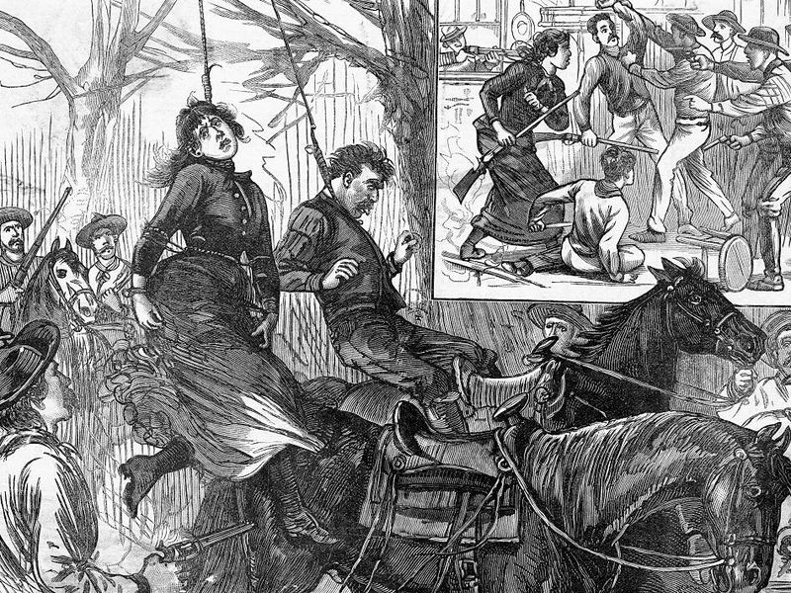
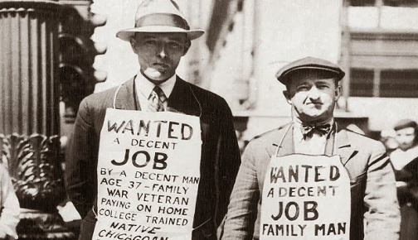
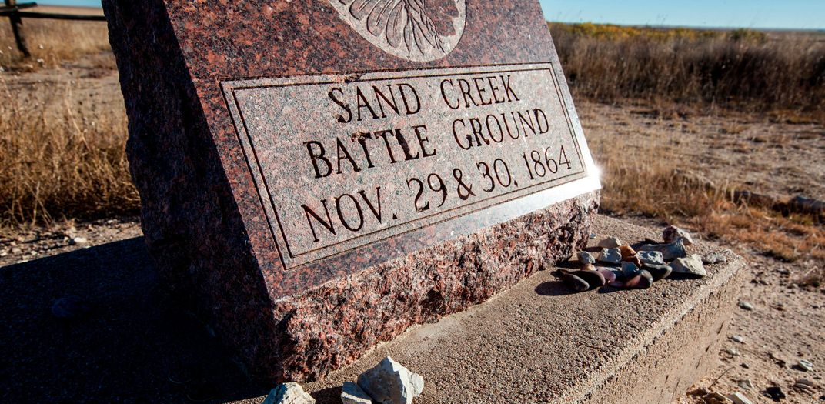
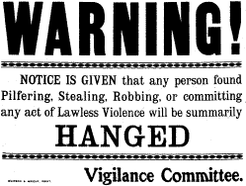
R.S2 Images relating to key events
The ritualistic ‘Ghost Dance’.
The Indian Frontier of 1834 was established to the right of the Indian Territory.
The Plains Indian territory which white migrants were allowed to cross.
Route of the Mormon migration.
General Custer..
The death of Ella Watson and Jim Averill.

Slide 13
TASK: Each of the cards relates to one of three key strands within this unit:
The experiences of the Plains Indians.
The experiences of migrants and homesteaders.
The experiences of cowboys and cattle ranchers.
Organise your cards (along with their corresponding images) into three groups on your desk to reflect these three strands.

Slide 14
R.S1 Key events in the American West
In 1848, a carpenter called James Marshall discovered gold in California. Once news of the discovery spread, thousands of migrants made the journey to California to seek out gold. | In 1874, barbed wire was invented. This invention changed the lives of settlers who had moved West, because for the first time they could protect their new land holdings from wandering cattle. This allowed them to become more prosperous. | In 1890, a group of US soldiers opened fire on a group of Sioux Indians who were simply performing a ritualistic dance. The event became known as the Wounded Knee Massacre.
The Indian Frontier Act of 1834 meant that there was a permanent divide between lands designated to the Plains Indians, and ‘white American’ lands. | In 1890, the US government announced the closure of the Indian Frontier. After this point Plains Indians were not considered to have their own identity: they had to integrate into US society and culture. | In 1837, the USA suffered an economic depression, which saw many banks in the East collapse. People lost their savings, wages fell and unemployment rose. Many people decided to seek their fortunes in the West.
Cattle ranching had been established in Johnson County since the 1870s, and wealthy ranch owners wanted to extend their power. In 1892, the cattle barons employed a vigilante group to get rid of ‘rustlers’ stealing their cattle. | In the 1850s, vigilance committees were formed in response to the crime and violence that went on between cowboys and cattle ranchers in the new towns of the West. | In 1867, Joseph McCoy realised the potential of the city of Abilene as a transit point for cowboys wanting to move their cattle to the big cities of the North.
The 1851 Fort Laramie Treaty said that certain lands belonged to Plains Indians, as long as the Indians allowed white migrants to travel across those lands. | In 1846-7, a large group of Mormons – facing persecution and discrimination in the East – decided to migrate to Salt Lake City in Utah. The migration took several months, and the journey was hard. | Billy the Kid was a famous gunfighter, employed by a group of ranchers to protect their business interests against rival businesses. Billy was eventually killed in 1881 after a bounty was put on his head.
The Pacific Railroad Act of 1862 provided funding for two railroad companies to extend the railroads further West. The completed railways allowed even larger-scale migration westward. | An armed force led by a US colonel attack Black Kettle’s camp of Cheyenne Indians at Sand Creek in 1864. The attack happened in revenge for Plains Indian attacks on the wagon trains of settlers. | The 1876 Battle of the Little Bighorn saw the US army defeated by the Plains Indians, and the famous US army leader, General Custer, killed.
The 1870s saw a ‘beef bonanza’, as demand for beef in the big cities increased dramatically. This allowed several cattle ranchers to become very rich, and they became known as ‘cattle barons’. | Between 1861 and 1865, the Northern US states fought a Civil War against the Southern states. Eventually, the Northern states won. Keen to consolidate their hold over the whole of the USA, the Northern government encouraged migration West. | In 1889, Ella Watson and Jim Averill – the owners of a homestead in Wyoming – were accused of stealing cows from local ranchers. The ranchers decided to take it upon themselves to eradicate ‘rustlers’, and both Watson and Averill were killed.

Slide 15
TASK: Now that you have organised the cards into three groups, arrange the cards in each group into chronological order (earliest to latest).
What was the ‘story’ of the Plains Indian experience in the American West? What about the homesteaders and the cowboys? Did these groups’ experiences change over time?

Slide 16
TASK: Look at the cards relating to the Plains Indians. How would you describe the US government’s attitude towards the Plains Indians?
Write as many adjectives as you can to describe the government’s attitude towards the Indians (one post-it per adjective).
Extra Challenge
The Plains Indians.

Slide 17
TASK: Look at the cards relating to the migrants and homesteaders. How would you describe the life of a migrant/homesteader?
Write as many adjectives as you can to describe the experiences of the migrants/ homesteaders (one post-it per adjective).
Extra Challenge
The migrants and homesteaders.

Slide 18
TASK: Look at the cards relating to the cowboys and cattle ranchers. How would you describe the life of a cowboy/cattle rancher? In your group, write as many adjectives as you can to describe the experiences of the cowboys/cattle ranchers (one post-it per adjective).
Post your post-it notes up on the board!
Extra Challenge
The cowboys and cattle ranchers.

Slide 19
... Which of the three groups’ experiences were the most positive? Which were the most negative? Which group experienced the biggest change?
Why do you think this might be?

Slide 20
Which of the following statements are true of the American West in the period 1835-1895? Copy down the statements that are true.
Migrants decided to move West because of negative experiences at home in the East.
Factors like the growth of the railroads discouraged migrants from making the move West.
The US government allowed the Plains Indians to continue living their traditional way of life.
Some cattle ranchers became very rich, because demand for beef increased in the mid 19th century.
The period of greatest migration happened before the California Gold Rush.
Cowboys became involved in conflicts between settlers in the West.

Slide 21
Which of the following statements are true of the American West in the period 1835-1895? Copy down the statements that are true.
Migrants decided to move West because of negative experiences at home in the East. T
Factors like the growth of the railroads discouraged migrants from making the move West. F
The US government allowed the Plains Indians to continue living their traditional way of life. F
Some cattle ranchers became very rich, because demand for beef increased in the mid 19th century. T
The period of greatest migration happened before the California Gold Rush. F
Cowboys became involved in conflicts between settlers in the West. T
Extra challenge: Add some more statements of your own.

